Slide 1
CROP PRODUCTION

Slide 2
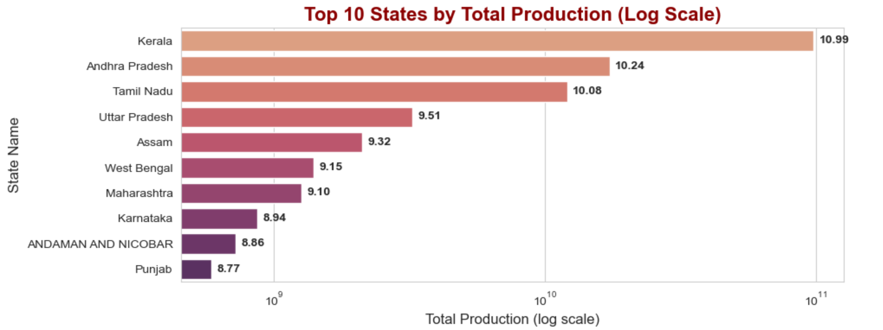
Maximum crop producing state = Kerala followed by Andhra Pradesh and Tamil Nadu.

Slide 3
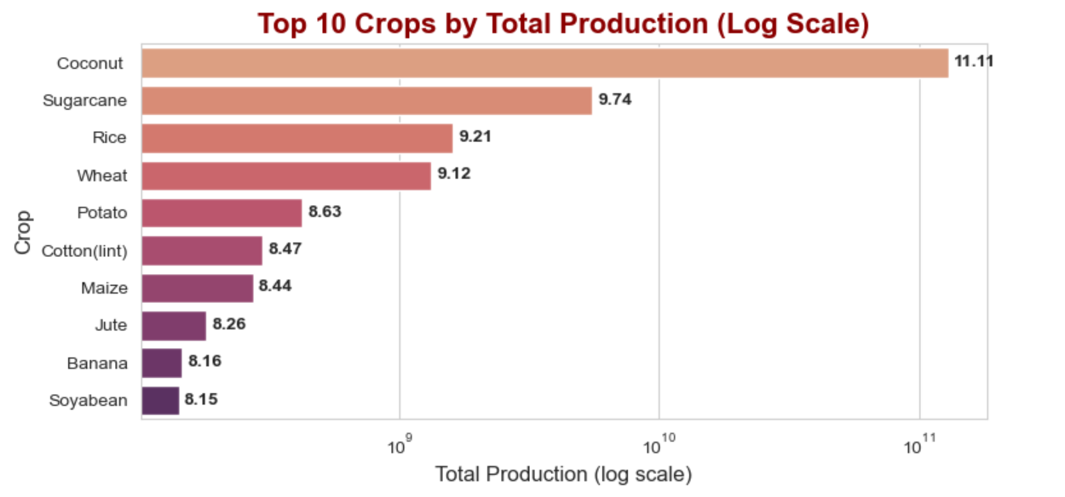
Maximum crop production = Coconut

Slide 4
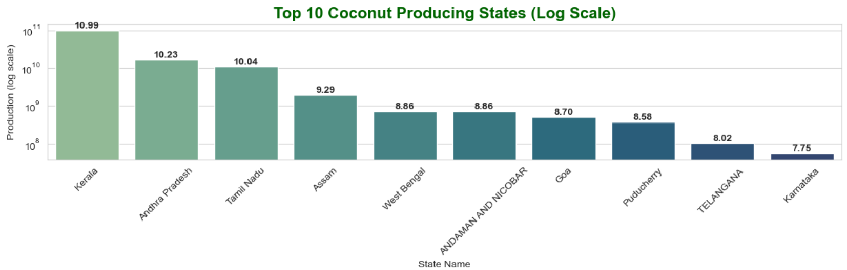
Maximum Coconut producing state = Kerala

Slide 5
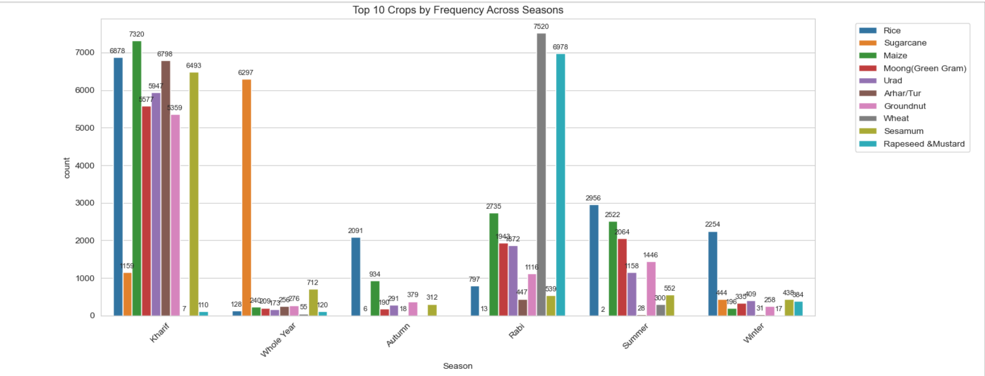
-Kharif season dominates in terms of crop frequency across all top 10 crops. -Sugarcane appears consistently high in “Whole Year” (as expected). -Wheat and Rapeseed & Mustard show strong presence in the Rabi season. -Rice and Maize span across nearly all seasons, highlighting versatility. -Sesamum and Arhar/Tur are almost exclusively grown in Kharif.

Slide 6
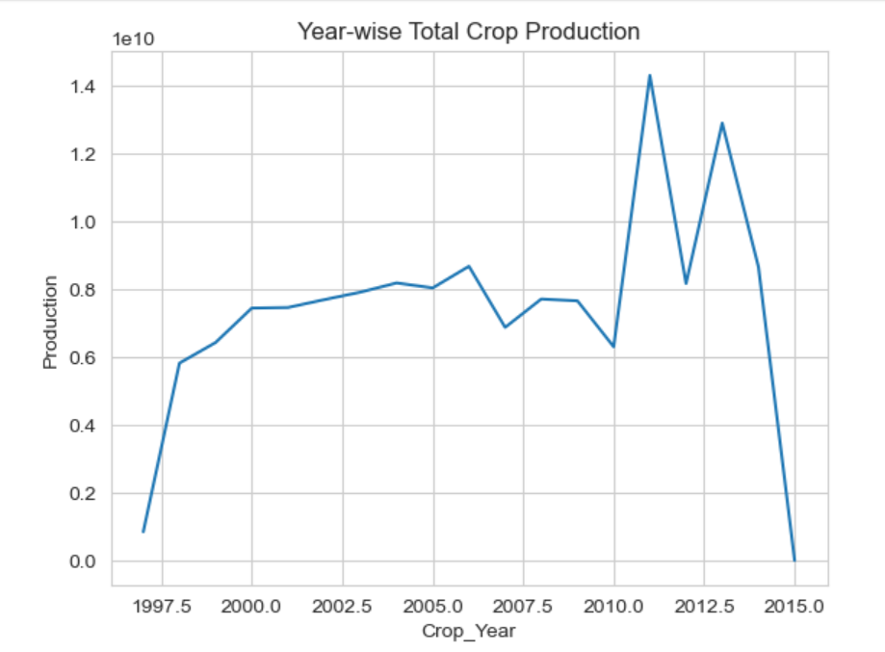
There is sudden rise in production in 2011 and downfall in 2012 and again rise in 2013.

Slide 7
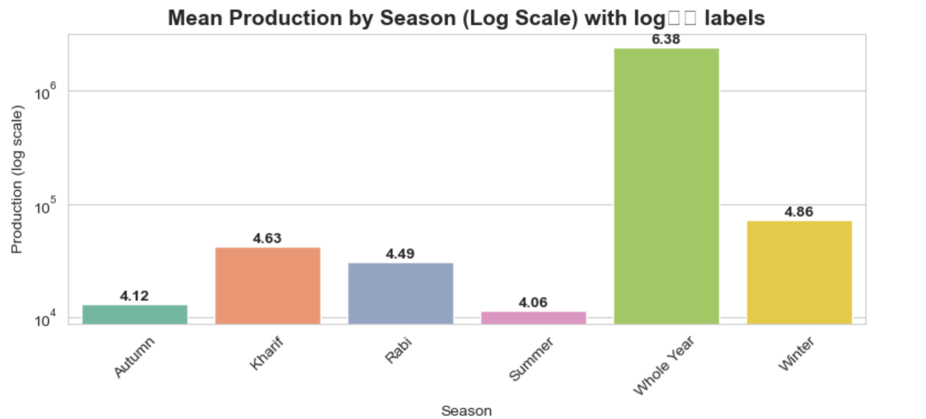
-Whole Year Cultivation Has Highest Mean Production: -Autumn and Summer have the lowest mean values, around 13,066 and 11,522 respectively -Mismatch Between Frequency and Production: -Kharif had the most entries in the earlier countplot (i.e., most frequently cultivated), but not the highest production -per record.¶ -This indicates many small-scale or lower-yield entries in Kharif vs. fewer but larger production entries for whole-year crops.

Slide 8
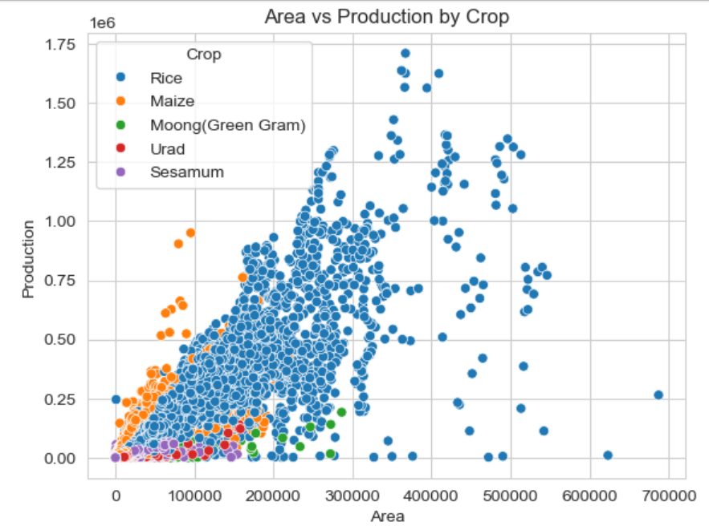
Does more area always mean higher production? At certain level of area, production increased. After that the production declined. Factor Explanation: Soil fertility limits: Beyond a certain size, you may be farming marginal land with poorer soils. Management intensity: It’s harder to maintain uniformly high inputs (irrigation, fertilizer, pest control) over very large tracts.

Slide 9
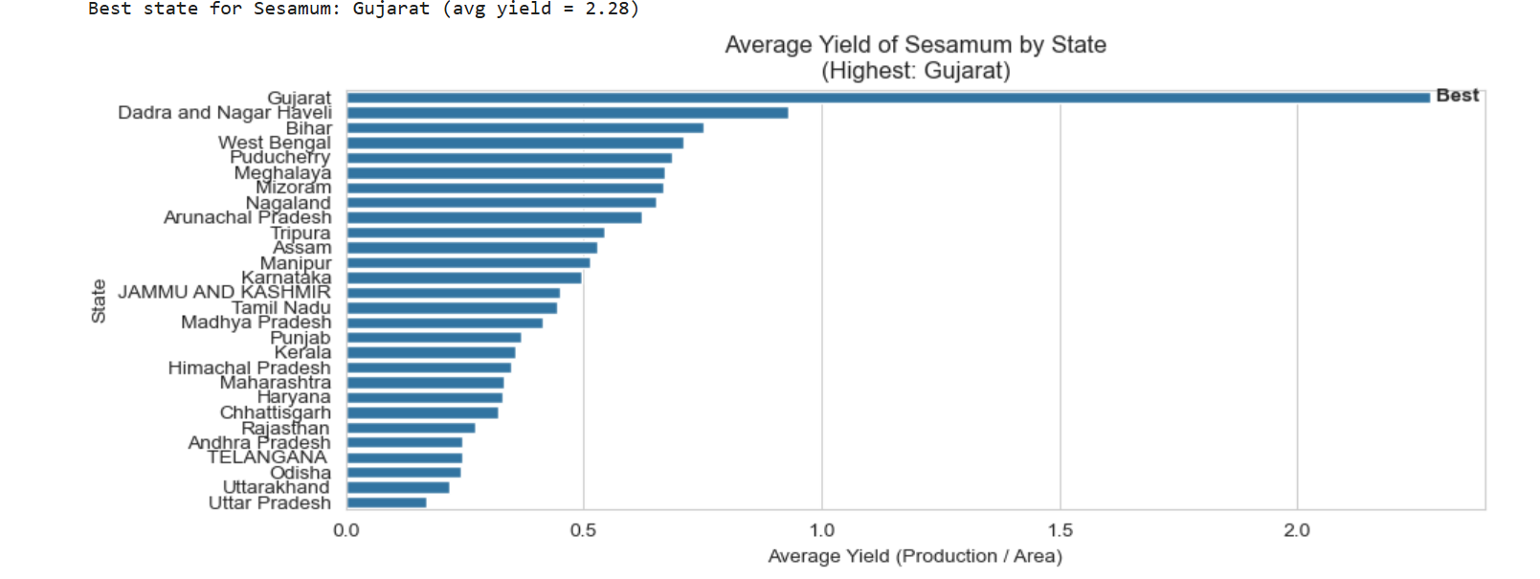
Best State for Sesamum = Gujrat

Slide 10
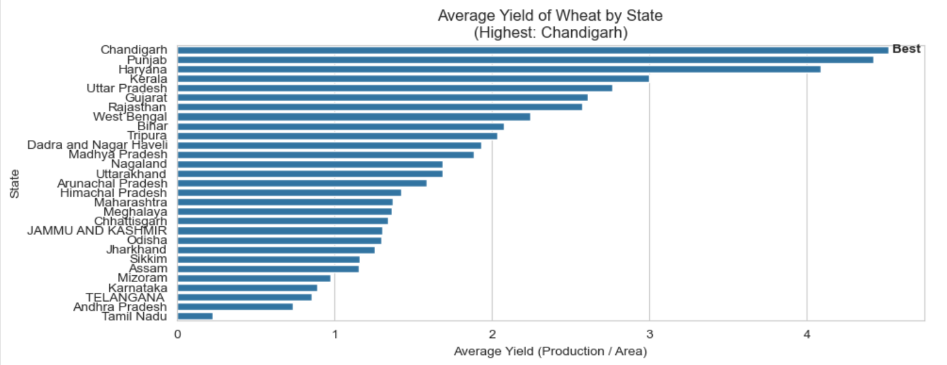
Best State for Wheat = Chandigarh

Slide 11
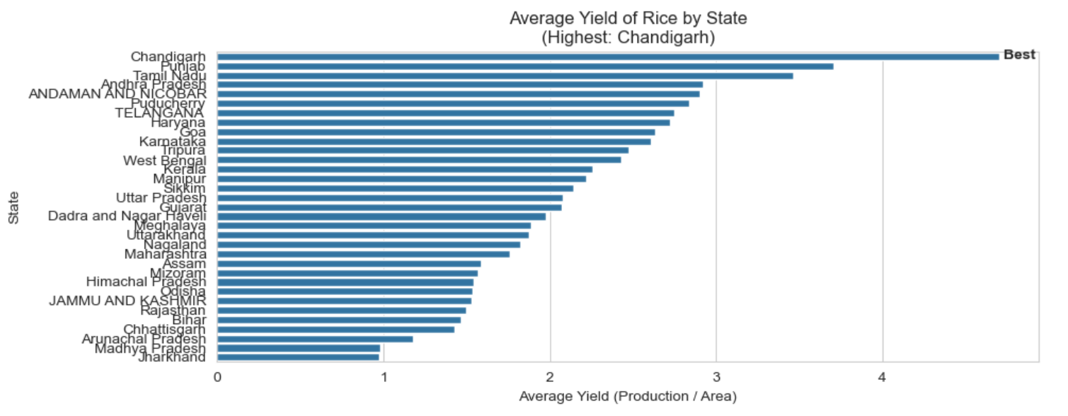
Best State for Rice = Chandigarh

Slide 12
Observations:
Maximum crop producing state = Kerala followed by Andhra Pradesh and Tamilnadu
Maximum crop production = Coconut
Maximum Coconut producing state = Kerala
Kharif season dominates in terms of crop frequency across all top 10 crops.
Sugarcane appears consistently high in “Whole Year” (as expected).
Wheat and Rapeseed & Mustard show strong presence in the Rabi season.
Rice and Maize span across nearly all seasons, highlighting versatility.

Slide 13
Sesamum and Arhar/Tur are almost exclusively grown in Kharif.
Whole Year Cultivation has highest Mean Production.
Autumn and Summer have the lowest mean values, around 13,066 and 11,522 respectively
Mismatch Between Frequency and Production:
Kharif had the most entries in the earlier countplot (i.e., most frequently cultivated), but not the highest production per record.
This indicates many small-scale or lower-yield entries in Kharif vs. fewer but larger production entries for whole-year crops.
Top producing districts are ALAPPUZHA > AMROHA > AHMADNAGAR > AMRITSAR > ANANTPUR > AMBALA > ALIGARH > AGRA

